Slide 1
CSU-Teikyo Study Abroad Program in Japan May 16-29, 2012
Spend Maymester in Japan studying Japan’s contributions in technology

Slide 2
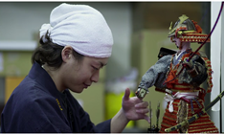
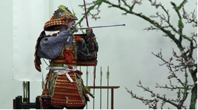
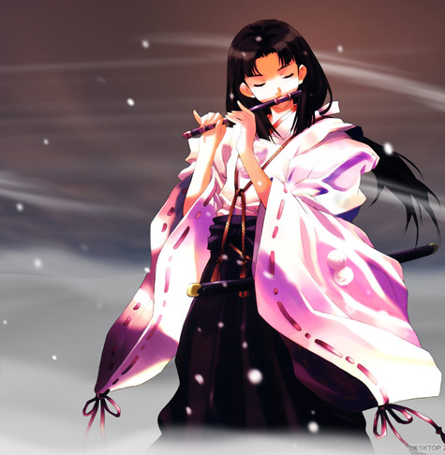
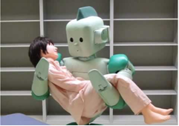
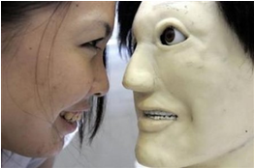
Anime / Robots Computer Games Communications
Experience first-hand Japan’s contributions to technology by active immersion in the culture and society of Japan.

Slide 3
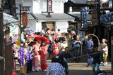
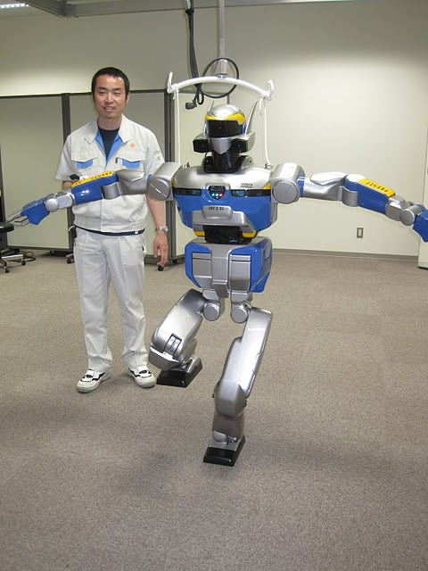
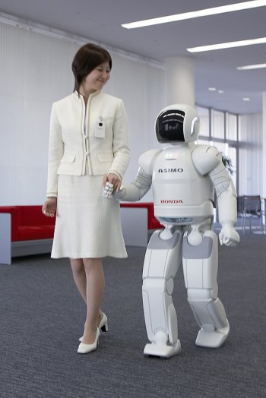
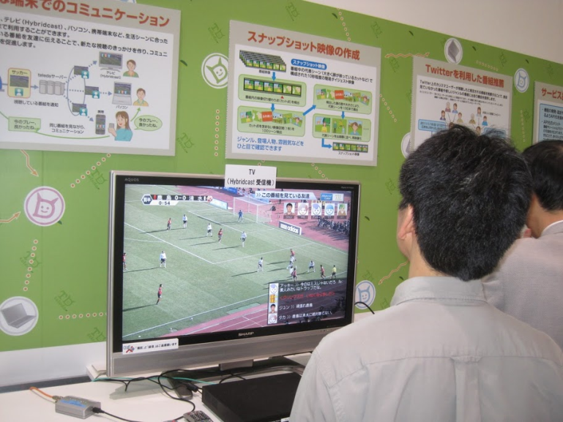
Among the sites you will visit are
Suginami Animation Museum ,
Kawada Industry (Mechatronics Division),
Honda Collection Hall (home of Asimo),
NHK Science and Technology Research Labs (developer of Super HiVision),
Nikko Edo-mura, and
Sony Building.

Slide 4
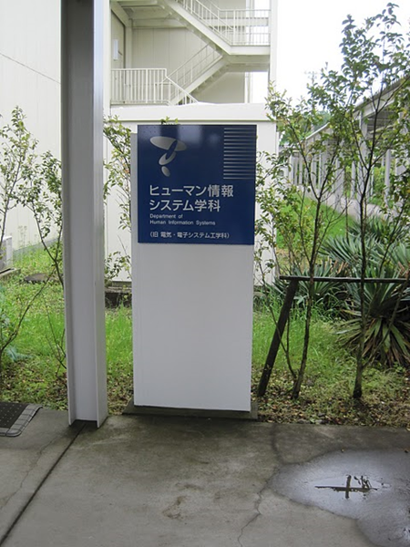
Hosted By Teiko University
Hachioji Campus
Utsunomiya Campus

Slide 5
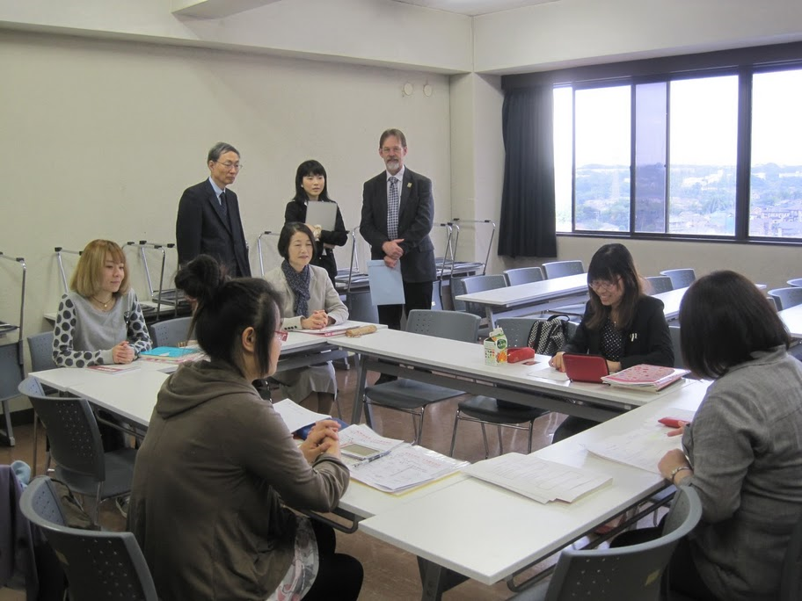
Make New Friends Learn Japanese Explore Japanese Technology
Computer
Science
Projects
Class
Japanese
Language
Class

Slide 6
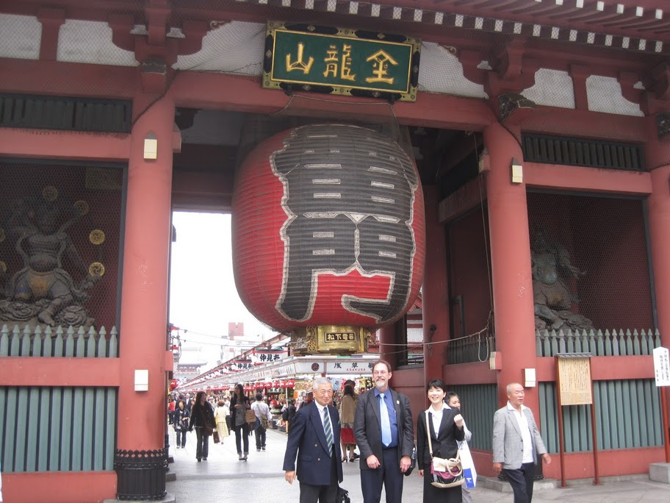
Explore Japanese Culture
Tea Ceremony
Shoji Temple

Slide 7
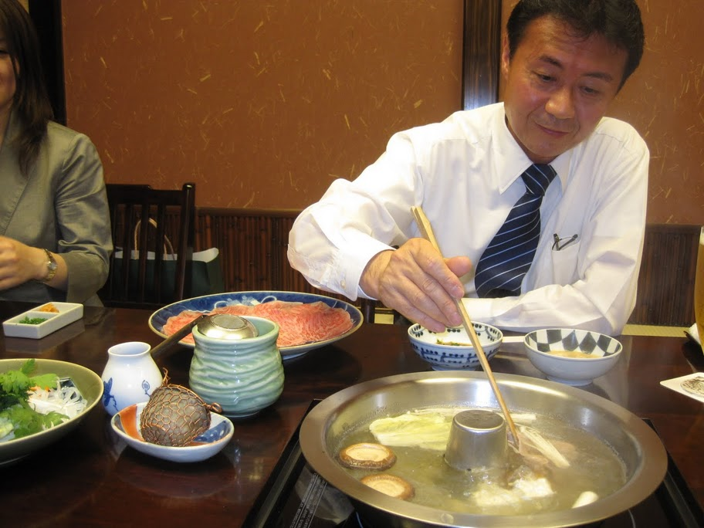
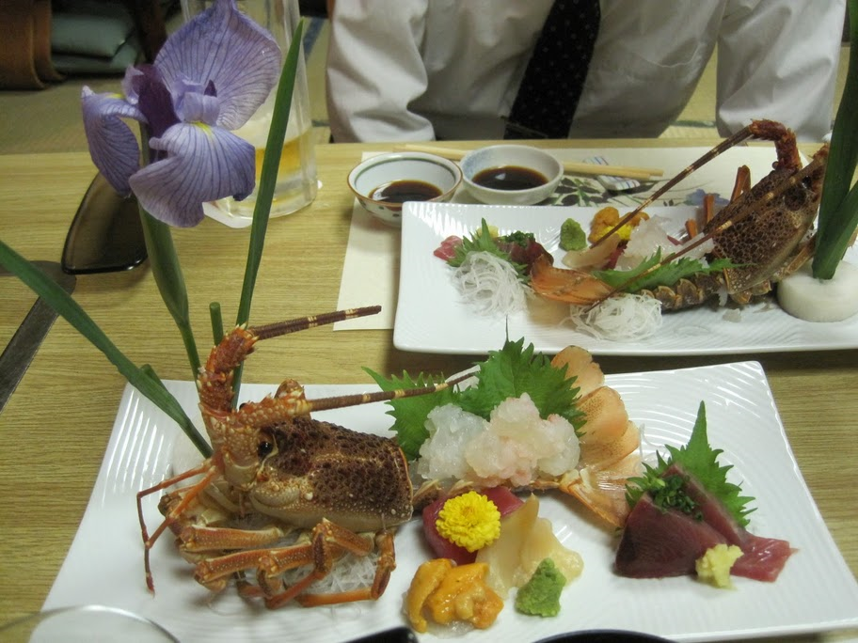
Eat Great Food
Shabu-Shabu ->
<- Sushi / Sashimi v

Slide 8
QUESTIONS / MORE INFORMATION
For more information contact:
Dr. Lydia Ray ray_lydia@ColumbusState.edu
Dr. Wayne Summers wsummers@ColumbusState.edu
CCT453 / 706-507-8170
For information about the class:
http://csc.columbusstate.edu/summers/NOTES/5555-japan/
Contact CIE for information about financial aid and to apply http://cie.columbusstate.edu/

